Slide 1
Week 2

Slide 2
A bit of Review
Tell me something you learned last week:

Slide 3
A Bit of Review
HTML is used to build our content.
We place all our content within HTML ‘tags’
We call these elements.
HTML is NEVER used to format our web-page!!! That’s what CSS is for!
CSS is used to format our content.
CSS stylesheets give life to our content
CSS is COMPLETELY separate from the content!

Slide 4
Our First Webpage!
W2:helloworld

Slide 5
yourturn1

Slide 6
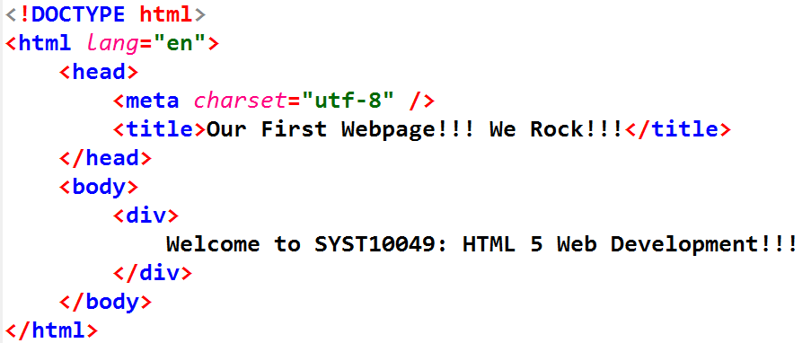

Our First Webpage…
Doc Type: All webpages start with this
ourfirspage.html
HTML tags
All our content is enclosed in html tags
There are two containers inside of the html tags
Notice the starting tags and an ending tags.
They enclose everything between them

Slide 7
Our First Webpage…
1-1-ourfirspage.html
The head tags contain information that is useful to search engines.
All of the information inside of the head tags is invisible to the end-user except for the title tag.
We call this meta data. We will learn more about meta-data in later weeks. Meta data is data that describes data.
We also put links to other files such as script files and CSS files in the head.

Slide 8
Our webpage…
1-1-ourfirspage.html
The body tags contain our content. All of the stuff that we put in here will be displayed by the browser

Slide 9
Question – Why did index.html come back instead of aboutus.html?

Slide 10
Anatomy of an HTML element
element
<p>Hello there</p>
content
Start tag
End tag
<p> is a paragraph tag

Slide 11
Anatomy of an HTML element (tag)
attribute
<a href="aboutus.html">About Us</a>
Start tag
content
End tag
This is an anchor tag…It allows us to display (hyper)links to other documents
Let’s add it to our index.html - uh oh! We just linked to a file that doesn’t exist

Slide 12
So far, we’ve only worked in the Body. Let’s change the TITLE of our page!
The title tag sets the title of the tab in the browser.
It is always found inside of the <head> tags

Slide 13
Our webpage…
Notice that the tags are indented to make it easier for us to read our code…this is important in large documents!
Fortunately, VSCode helps us out with this!!!

Slide 14
Hmmm…what about img???
<img src="HTML5_logo.png" alt="this is the alternative text">
Notice anything weird about this?

Slide 15
What is this meta tag?
Meta data is data that describes data.
Meta tags are often used to assist in SEO (search engine optimization) or screen readers
This tag is describing the character encoding of the webpage
This meta tag tells the browser that the character set that we wish to use is utf-8.
utf-8 is rapidly becoming the default character set for the world!

Slide 16
hmm…something’s different?
Notice that the <meta> tag doesn’t have a corresponding </meta> tag.
Shouldn’t it look like this?
Since the meta tag doesn’t contain any content, we sometimes use a shortcut and add the /> at the end of the tag instead of > </meta>

Slide 17
Spend 10 minutes and mess around with your webpage in yourturn1

Slide 18

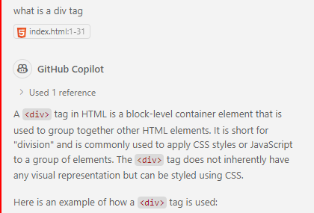
What is a div tag?
How will you find out what a div tag is?

Slide 19
Containers in Containers in Containers…
the <html></html> element is a container that contains all of the html elements in our page.
The <head></head> element is a container that contains all of the administrative data required by our page.
The <body></body> element contains all of the content that will be displayed in our webpage
These elements are similar in that we only have one of each in our page.

Slide 20
Containers in Containers in Containers…
It turns out that divs are containers too.
Divs are generic containers that can contain any elements that we choose to put inside them.
We tend to use divs to group items for the purpose of formatting them in the CSS.
Unlike, html, head and body, we can have many divs in a single document.
We can even have divs inside of divs (and we often do!)

Slide 21
<div> containers
Demos/containers

Slide 22
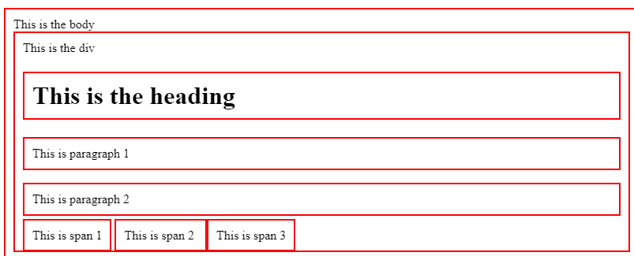
Div vs span
Div
Span
A generic container that we can put stuff in.
Works on a block level (takes the whole line)
Starts a new line and has width equal to page or parent container
A generic container that we can put stuff in.
Works on an inline level
Does not start a new line!
So, what level does <p> operate on?

Slide 23
One thing that both Div and span have in common
They are both non-semantic tags
This just means that they are generic containers. We can put anything inside of them but the div or span doesn’t convey any other meaning.
Div and span have no ‘meta-information’ attached to them

Slide 24
Semantic vs non-semantic tags
So, we’ve seen that DIV and SPAN are generic containers but they don’t describe anything about themselves (They do not provide any metadata). They are non-semantic tags
Semantic tags have meaning. They tell us about what is stored inside of them
For example, what do you suppose would be stored inside of <header> <footer> <article> <nav> tags
These are basically divs but they have special meaning, based on their name
<header> is going to contain things at the top of the page
<footer> is going to contain things at the bottom of the page

Slide 25
Ok, but they are just <DIV> tags with fancy names, right?
Weelllll, ya….BUT
Semantic tags have some advantages:
SEO
search engines use the <header> and <footer> in their algorithms
Accessibility
Screen readers use semantic tags to understand more about what is going to be found in them.
Code Readability
In a large page, using tags with semantic meaning can make it much easier to understand what is going on, vs using a bunch of generic, non-semantic tags

Slide 26
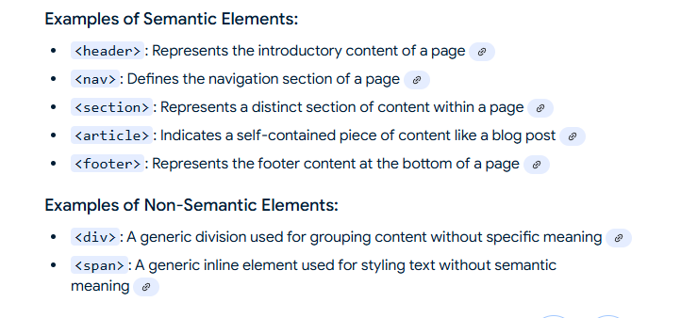
Some examples of semantic tags

Slide 27
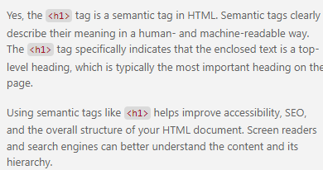
What about <h1>
Semantic or non-semantic?

Slide 28
Finding the Flow!
When a browser reads our html, the first thing it does is start at the top of the document and flow all of the elements onto the screen.
Think of it as the browser pouring all of the elements into the page.
The browser follows a set of rules to determine how to flow these elements.

Slide 29
Notice the “Flow” of content in our page…
Many elements flows underneath the previous element.
All of these kinds of elements are “block-level” elements.
This means that they expand to fill the entire width of the browser so that the next element flows under it.
Notice that some, like <span> don’t take up the whole line. They are “inline” elements

Slide 30
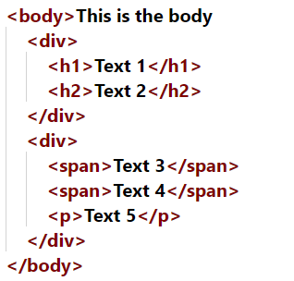
Draw the Flow of this HTML

Slide 31
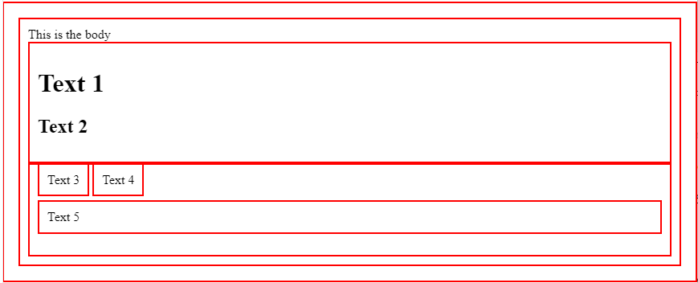
Answer

Slide 32
Tell me everything you can about an <em> tag?
Emphasize tag
Semantic
Inline

Slide 33
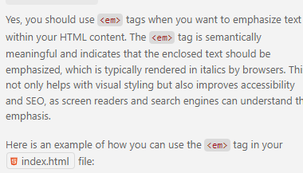
hmmm…I thought html was supposed to be all about the content and nothing about the formatting?
In fact, this italic isn’t coming from html!
Browser vendors include a default CSS stylesheet that they apply to all pages.
However, we can override this!
Question: Why would we want to use an <em> tag when we could just use a <span> tag and style it with CSS?

Slide 34
Comments
Comments are ignored by the browser!
They are like little post-it notes to us to remind us what we were thinking.
In HTML, a comment looks like this
<!-- our comment text -->
In CSS, a comment looks like this:
/* our comment text */

Slide 35
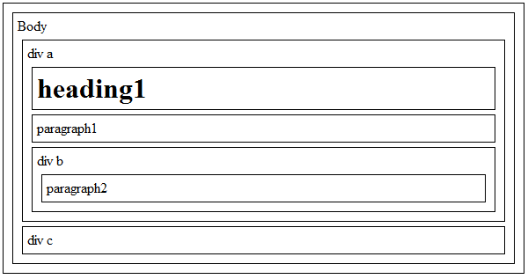
YourTurn 2 - Build me an html page that has the following flow:

Slide 36
Hmmm…what if we mess up the HTML?
Short answer – this is bad
Longer answer – today’s browsers are getting pretty good at figuring out mistakes and rendering the page
DO NOT RELY ON THIS!
This can cause a lot of unanticipated results
One browsers renders differently than another
SEO
Etc.

Slide 37
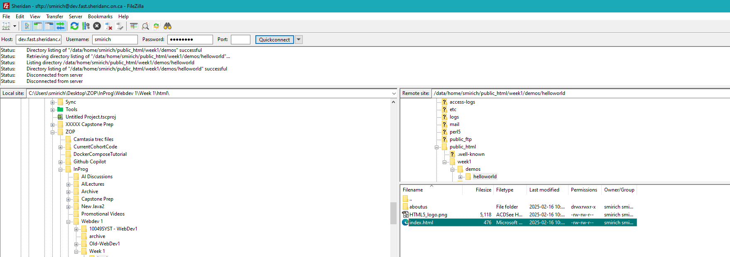
Let’s move our local code to the server

Slide 38
IC2
Follow the directions in the ic2 folder and then submit the url to the dropbox
Remember, make a .txt file with the url in it and then copy and paste that url into the comment section of the dropbox.

