Slide 1
Week 3
A tiny peek at CSS
Accessibility on the web

Slide 2
Tell me something you learned last week?

Slide 3
I think we forgot anchor tags!

Slide 4
CSS
Remember csszengarden.com?
HTML contains the information we need but CSS is what makes us want to read it!!!!
You can do amazing things with CSS

Slide 5
CSS – It’s great, but…
You can do amazing things with CSS
However, today, not too many people use CSS directly.
Today, we largely rely on frameworks to style our content but remember, no matter how fancy the framework, behind the scenes, it is still using CSS (and often javascript) to make things happen!
Understanding CSS and how it works will make you much more effective while using frameworks and AI.

Slide 6
Demo1 - css

Slide 7
Now we know why the call It cascading style sheets!
All things being equal, styling that occurs closest to the html element wins. However, things don’t have to be equal!
The rules cascade so that the closest ones are the ones that the browser applies
Every browser has a default stylesheet that is furthest away from the tag. If we don’t override the style, the browser will apply it’s own style.
Think about <h1> or <em>

Slide 8
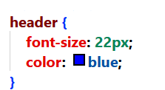
Make my own
Selector
Values
Property

Slide 9
Demo2 relative vs absolute

Slide 10
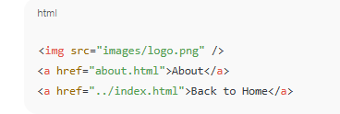

Absolute vs relative addressing
Absolute
Provides full path to the resource, starting from the root
Works anywhere because it is globally referenced (starts at the root)
Not affected by what folder your file is currently in
Includes protocol
Relative
Points to a file relative to the current document’s location
Same folder
about.html
Subfolder
folder/about.html
Parent folder
../about.html

Slide 11
yourturn1

Slide 12
We want our site as accessible as possible!
What kind of devices might people be using to access your site?
PC with modern browser
PC with outdate browser
Tablet
Kiosk
Smartphone
Watch
AI agent
Stuff we haven’t even dreamt of yet

Slide 13
Learn about progressive enhancement
How did you do this?

Slide 14
Progressive Enhancement
A site may be visited by a wide variety of clients:
New Web browser on a big monitor
Old web browser that doesn’t support some technologies
Small monitor
Tablet
Phone
Screen reader
Alexa/Google Home
AI agent
Search Engine

Slide 15
Progressive Enhancement
Our site should provide basic functionality that can be used by all devices first.
Next, we can layer on additional enhancements with css/javascript/services/advanced features
Doing this ensures that all devices can make use of our site.

Slide 16
Accessibility
Accessibility on the web
People that visit your site will have differing abilities
People that visit your site will have different devices
Sometimes it isn’t people visiting your site
Search engines
Web crawlers
Etc.
Soon, it could be AI visiting your site to do things

Slide 17
We want our site as accessible AND inclusive as possible!
What kinds of obstacles could people have when visiting your site?
Visual
Auditory
Motor
Cognitive
(Device)
It’s not just the right thing to do, it is often the law!

Slide 18
Learn about accessible web design How can we make our web content accessible

Slide 19
Accessible Web Design
So, if progressive enhancement allows our web content to be accessible to as many devices as possible, Accessible Web Design is about creating web content that is usable by as many people as possible.

Slide 20
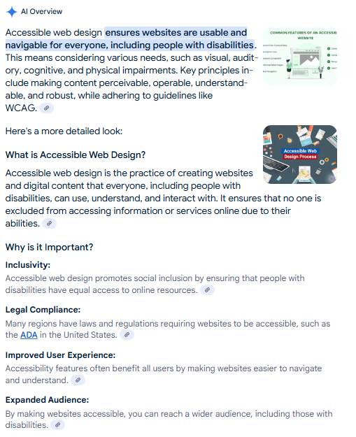
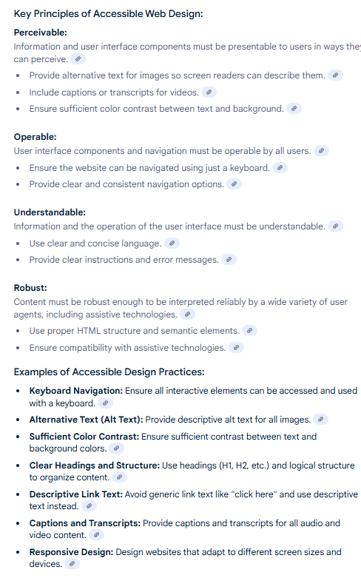
Accessible web design

Slide 21
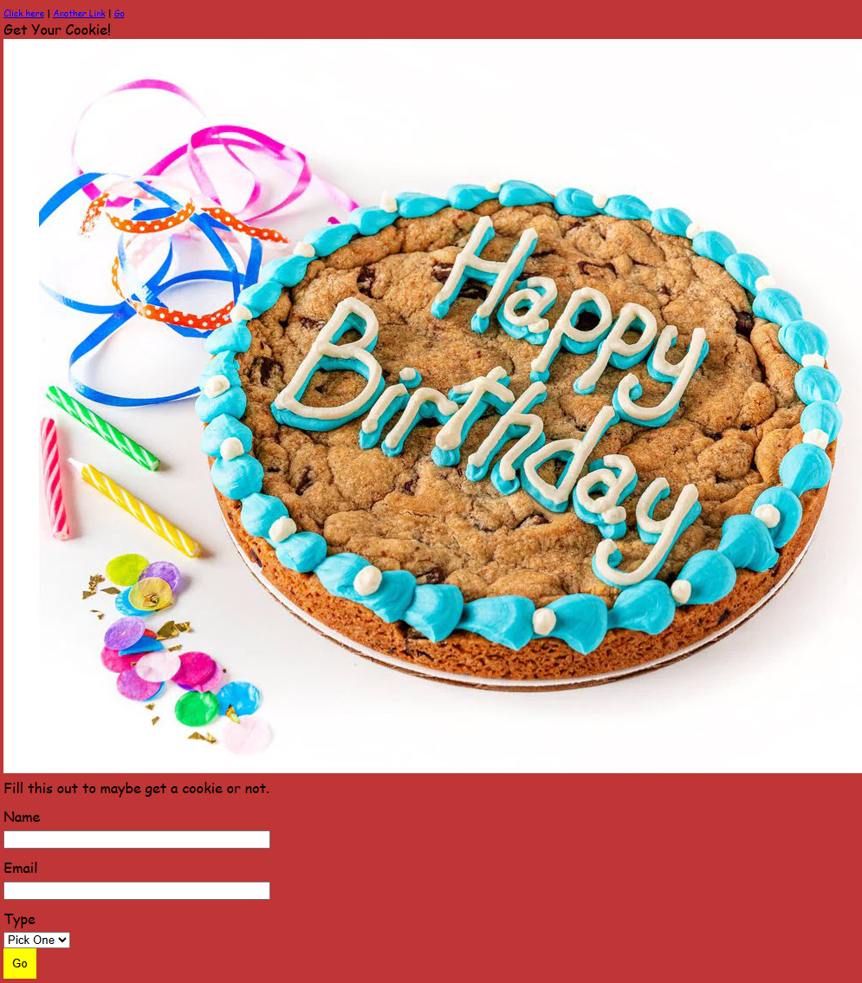
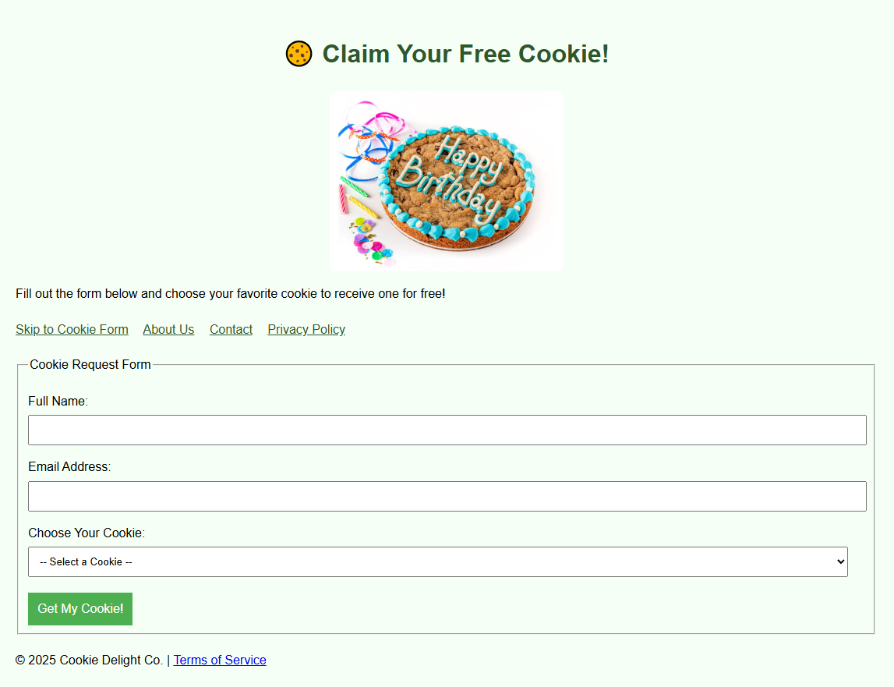
Let’s do this together

Slide 22
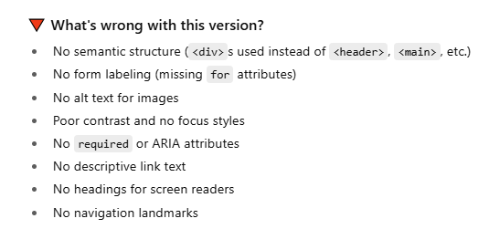
What’s wrong with this version?

Slide 23
How can we help?
Make our site:
Responsive to assistive devices like screen readers, magnifiers etc.
Images should all have alt text for screen readers
Semantic HTML containers make the screen readers’ jobs easier and more logical
Visually accessible with clean fonts and good colour contrast.
Easily navigated via the keyboard
Logical tab flow
Accessible forms use labels with every form field and that group relevant sections togther

Slide 24
How can we help with Visual challenges?
Semantic HTML
Use HTML elements according to their intended purpose to make content easy to understand and navigate. For example:
Use <header>, <footer>, <nav>, <article>, <section>, etc., instead of generic <div> tags.
Ensure your forms are well-structured with proper labels (<label>), form inputs (<input>, <textarea>, etc.), and <fieldset> for grouping related fields.

Slide 25
How can we help with Visual challenges?
Text size
Screen Readers
Screen Magnifiers
Colour Contrast
Organized content, logical cycling between components, etc.

Slide 26
How will AI impact the web?

Slide 27
Ask an AI engine what the effects of AI will be on search engines, advertising, and individual content creators You should pay particular attention to the answers. This will impact your life!

Slide 28
In class Assignment

